Slide 1
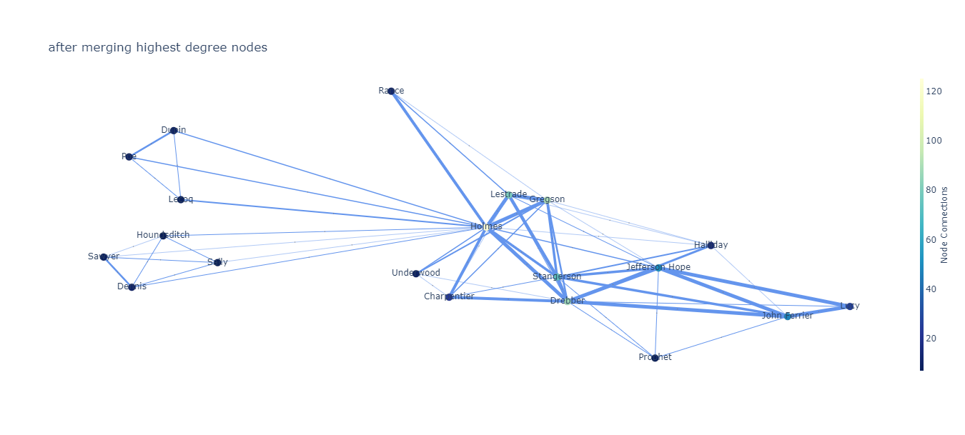
Visualizing Stories
Data Analytics and Visualization Winter 2021
Project Midterm Presentation
Mohammadamin Ghasemzadeh, Romina Abadi

Slide 2
Identify the characters
Network of interactions
Novels
INTRODUCTION
Insights into the books
visualize the stories
Notes:
This project is about data analysis on novels.
The main goal of the project is to identify the characters and find the network of their interactions.
Also, This project tries to visualize the stories.
The visualization and analyses can be used to discover new insights into the books before reading them.

Slide 3
Interaction dynamics and development
Motivation
Classical romance novels => relation patterns
“Is there a pattern in an author's writing?”
“Are some patterns more common in some eras or categories?”
“Does the pattern change in different eras?”
Pattern and popularity
Indicator of book recommendation system
Filtering books based on their story-line similarity
Applications
Text summarizing
Text containing characters: history, scripts, news, and etc.
Notes:
MOTIVATIONS:
Totally our motivation was finding patterns in the network of characters in novels. Then, see if there is any correlation between patterns and for example categories or authors or popularity.
POTENTIAL APPLICATIONS:
For instance, a book recommendation system can use such information as an indicator.
Also, another application that might be interesting is filtering books based on their story-line similarity to other books.
Also can be used in text summarizing.
Our method is extendable to any written text containing characters, For instance. novels, history books, news articles, movies or comic books, anything involving humans and interactions.

Slide 4
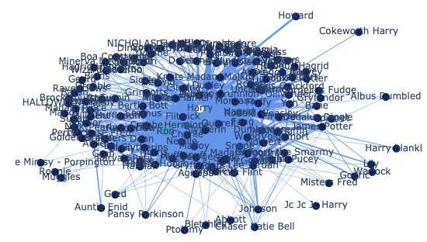
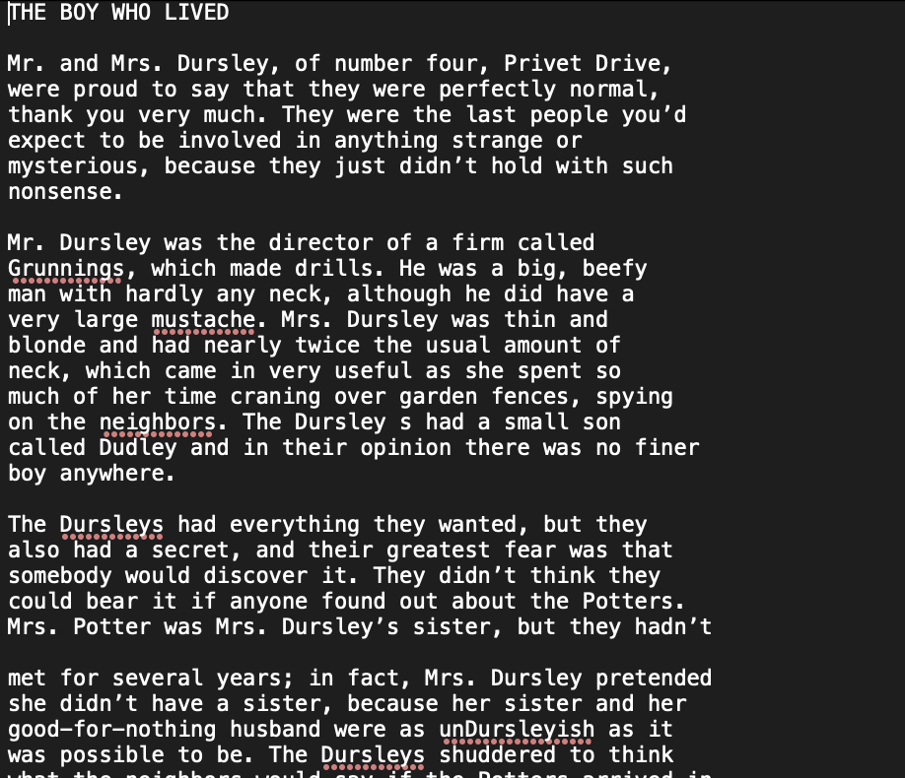
Problem Definition
Creating Network Interaction
Network Properties:
Multigraph
Nodes: Characters
Edges: Interaction
Network snapshots
Notes:
Our main focus was to create the interaction network from text.
The interaction network is a graph whose nodes are unique characters and edges are interactions between the characters. This network is a multigraph, which means there can be multiple edges between two nodes, which represent multiple interactions between the characters.
Multiple edges between nodes represent multiple interactions between the characters
Edges have timestamps indicating when the interaction happens.

Slide 5
Problem Definition Cont.
Network Analysis
Finding patterns in
Single work
Author’s works
Categories
Important Characters/ Important Relationships
Size of the graph and important subgraph
Graph changes through time
Notes:
Once we have the graph, there are some information that can be extracted from the graph.
The very basic analysis of the graph is to see how big it is (which is the number of characters) and we don’t need a graph to find that. But, what a graph also tells us is how big the central part of the graph is, which can indicate the story is mainly about how many people. Is the story built around a small group of people or is it about many different people.
Another thing is the importance of the characters, which is the node importance. (we haven’t done this but we may also rate importance of interactions to see what are the important relationships, the central relationships might not be obvious in a story but we can see if it actually gives any insights into the books or not).
What we have also done is to analyse the graph through time.
ASK AMIN: should I include a short definition?

Slide 6
Dataset and Methods
Project Gutenberg is a library of over 60,000 free eBooks
This dataset contains 3036 books from 142 authors. All books are in English, in “txt” format.
Notes:
For Dataset We used a subset of the Project Gutenberg which is a library of over 60000 free ebooks.
This dataset contains 3036 books from 142 authors. All books are in English, in “txt” format.

Slide 7
Dataset and Methods
Character Interaction Network is represented as an undirected, unweighted, dynamic multigraph 𝐺
10 lines
𝐺(𝑉, 𝐸) : The graph representing the network
𝑣 ∈ 𝑉 : a unique character
{𝑢, 𝑣, 𝑖}𝑡 ∈ 𝐸 : an interaction between characters u and v at time t
1. Name extraction
2. Creating a basic interaction graph
Named Entity Recognition(NER)
SpaCy
NLTK
Stanford CoreNLP
Tokens
“Mr. and Mrs. Dursley, of number four, Privet Drive, were proud to say that they were perfectly normal, thank you very much.”, Harry Potter and the Philosopher’s Stone
(‘Mr.’, ‘O’), (‘and’, ‘O’), (‘Mrs.’, ‘O’), (‘Dursley’, ‘PERSON’), (‘,’, ‘O’), (‘of’, ‘O’), (‘number’, ‘O’), (‘four’, ‘NUMBER’), (‘,’, ‘O’), (‘Privet’, ‘LOCATION’), (‘Drive’, ‘LOCATION’), (‘,’, ‘O’), (‘were’, ‘O’), (‘proud’, ‘O’), (‘to’, ‘O’), (‘say’, ‘O’), (‘that’, ‘O’), (‘they’, ‘O’), (‘were’, ‘O’), (‘perfectly‘, ‘O’), (‘normal’, ‘O’), (‘,’, ‘O’), (‘thank’, ‘O’), (‘you’, ‘O’), (‘very’, ‘O’), (‘much’, ‘O’), (‘.’, ‘O’).
Notes:
METHODS:
1. To create the network, extracting characters names from raw text is needed. We used Named Entity Recognition(NER) to extract characters’ names. There are various libraries in python that provide NER. We compared three packages and chose the Stanford CoreNLP for its accuracy. To identify the character names from text, first the raw text is turned into tokens, using Tokenizer. The tokens are words or punctuation marks.
***example of tokens
2. Character Interaction Network : To create the character interaction network, we used co-occurrence method.
If two names appear closer than 𝑘 lines together, an interaction is identified.

Slide 8
Dataset and Methods
3. Merging similar nodes
Harry Potter
HARRY
Mr. James Potter
Mr. Scrooge
Mr. Potter
Ebenezer Scrooge
Mrs. Potter
Harry Potter
Similarity
Conditions
Harry Potter [‘HARRY’, ‘Mr. James Potter’, ‘Mr. Potter’, ‘Mrs. Potter’]
Ebenezer Scrooge [‘Mr. Scrooge’, ‘Ebenezer Scrooge’]
Removing
Conflicts
Harry Potter [‘HARRY’, ‘Mr. Potter’]
Mr. James Potter
Mrs. Potter
Ebenezer Scrooge [‘Mr. Scrooge’, ‘Ebenezer Scrooge’]
Notes:
3. Merging Similar Nodes:
different appearances of the same character’s name are identified as different characters. We merge the nodes in the graph that represent the same character based on some conditions. However, under our similarity conditions, sometimes, conflicting names are grouped together (for example. people with similar family names are grouped together). We use conflicting conditions to remove such inconsistencies.

Slide 9
Analyses
Finding important characters
Sorting characters by Page-Rank
NetworkX
Centrality: 𝛴Page-Rank=0.5
Finding Character Importance Change through Time
Degree Distribution of Character Interaction Networks
Notes:
PROPOSED ANALYSIS:
1. Finding Important Characters:
Important characters are extracted from the text by sorting the characters based on their page-rank, which is available in NetworkX library. Central part or important characters of a graph are the people who has total page rank of 0.5
2. Character importance through time is plotted by finding 𝑘 characters with the highest Page-Rank scores, and plotting their Page-Rank in thirty snapshots of the story’s timeline.
3. Also we use degree distribution, to answer if a network is a scale-free network or not. For example If yes, what is the slope.

Slide 10
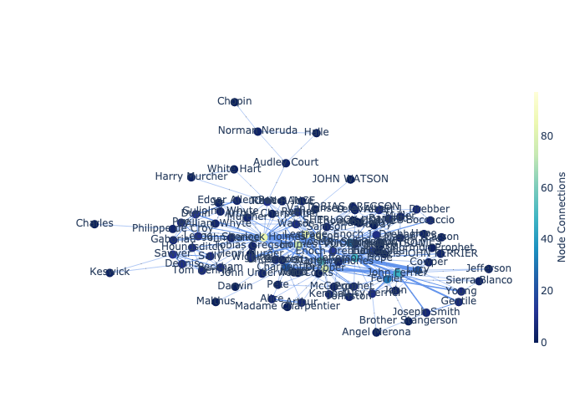
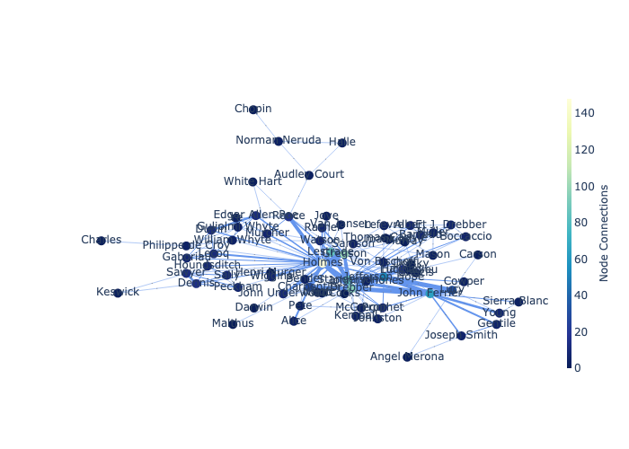
Results: Graph Before and After Merge
A Study in Scarlet, Sir Arthur Conan Doyle
Nodes: 101 -> 74
Good merges:
Holmes ['Sherlock Holmes', 'SHERLOCK HOLMES', 'MR. SHERLOCK HOLMES']
Stang erson ['Joseph Stangerson', 'Brother Stangerson']
Bad merge:
Charpentier ['Arthur', 'Madame Charpentier', 'Arthur Charpentier']
Notes:
Because we have focused on creating the graph, and mergin similar nodes, I wanted to show you one of our merge results.
These are examples of good merges, as you can see, we believe these are the same people. But here, we know Madame Chaprpentrier’s name cannot be arthur, but our code doesn’t know that. Lets go to analyses we have done so far

Slide 11
Results: Important Characters
Book | Main Character and Page Rank
Harry Potter and The Philosopher’s Stone ¹ | ‘Harry’: 0.22
Oliver Twist ² | ‘Oliver’: 0.14
A Christmas Carol ² | ‘Scrooge’: 0.23
A Study in Scarlet ³ | ‘Holmes’: 0.11
The Hound of the Baskervilles ³ | ‘Holmes’: 0.12
The Sign of the Four ³ | ‘Holmes’: 0.18
The Valley of Fear ³ | ‘Holmes’: 0.07
J. K. Rowling
Charles Dickens
Sir Arthur Conan Doyle
Notes:
We have created the graph for only seven books so far, we will do more. But let’s see examples of the restuls.

Slide 12
Results: Graph Size
Book | Graph Size | Central Graph Size
Harry Potter and The Philosopher’s Stone ¹ | 157 | 6 (ratio: 0.04)
Oliver Twist ² | 122 | 9 (ratio: 0.07)
A Christmas Carol ² | 38 | 4 (ratio: 0.10)
A Study in Scarlet ³ | 74 | 12 (ratio: 0.16)
The Hound of the Baskervilles ³ | 73 | 6 (ratio: 0.08)
The Sign of the Four ³ | 67 | 8 (ratio: 0.12)
The Valley of Fear ³ | 126 | 16 (ratio: 0.13)
J. K. Rowling
Charles Dickens
Sir Arthur Conan Doyle
Notes:
The next information is the size of the graph and the central part of the graph
The central part of the graph is the nodes with maximum page rank whose page rank adds up to 0.5. Here we can see also harry potter has a lot of characters but the central part of the graph has only 6 characters. On the other hand A Study in Scarlet has a lot less characters but the main part is bigger.

Slide 13
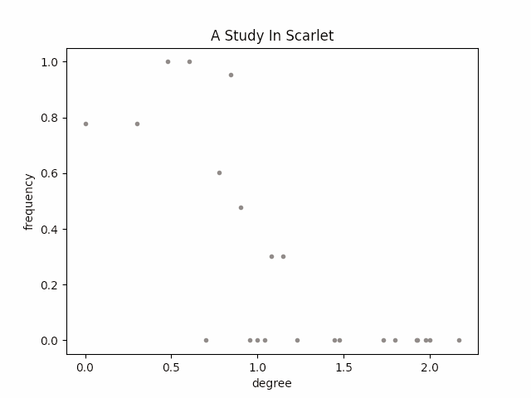
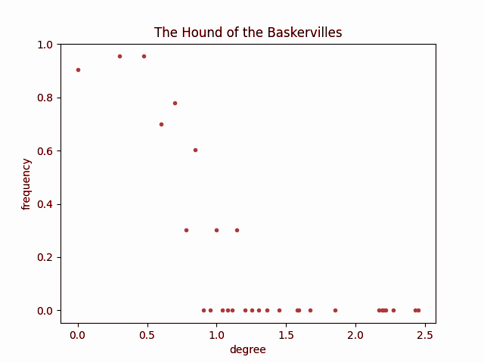
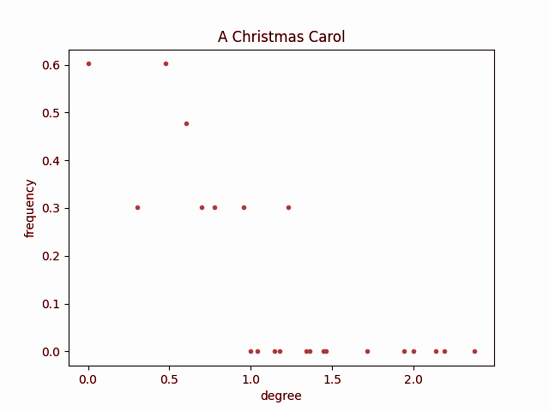
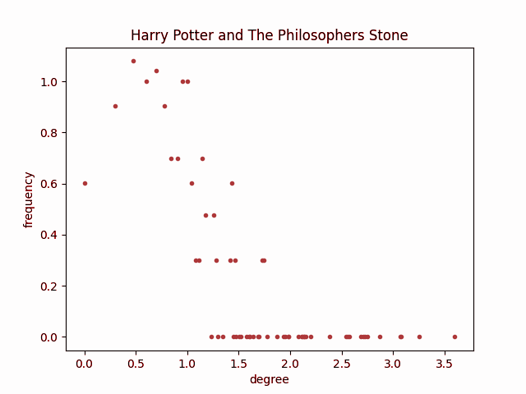
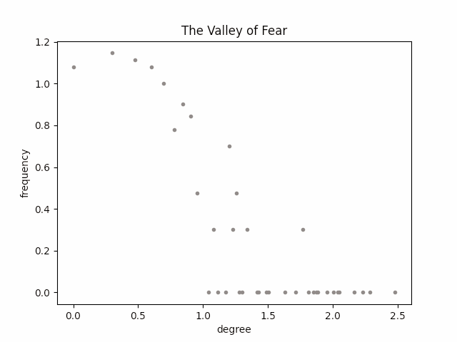
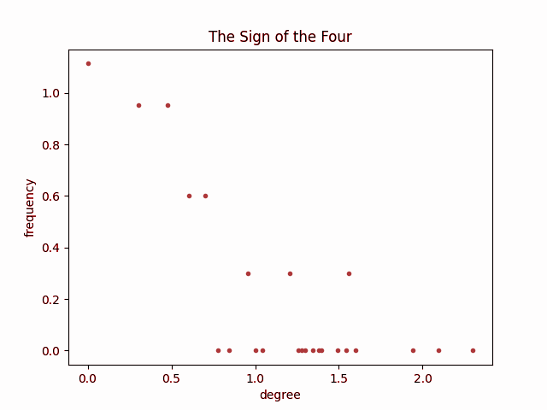
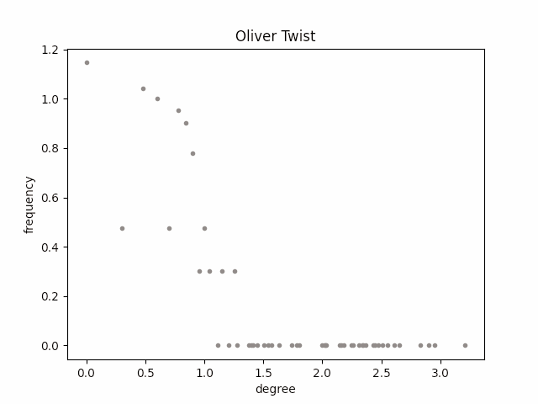
Results: Degree distribution
Notes:
We also plotted degree distributions and they all almost looked like the power law distribution. We did not find any interesting information here. These analyses were on the whole graph. But we also analysed the snapshots. Amin will show you the snapshots.

Slide 14
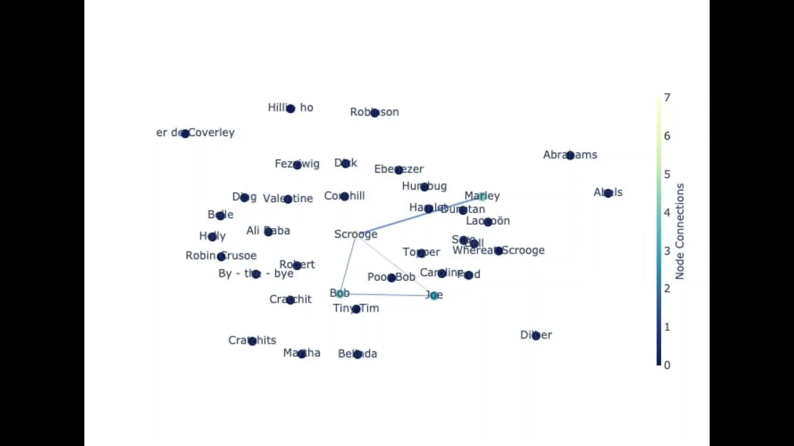
Results: Story Narration
Notes:
Here is a story narration of a novel by using 30 snapshots of the a christmas carol book by charles dickens
As you will see, scrooge which is the main character of the novel makes an interaction graph by a group of people (for example marley’s family) at each snapshot

Slide 15
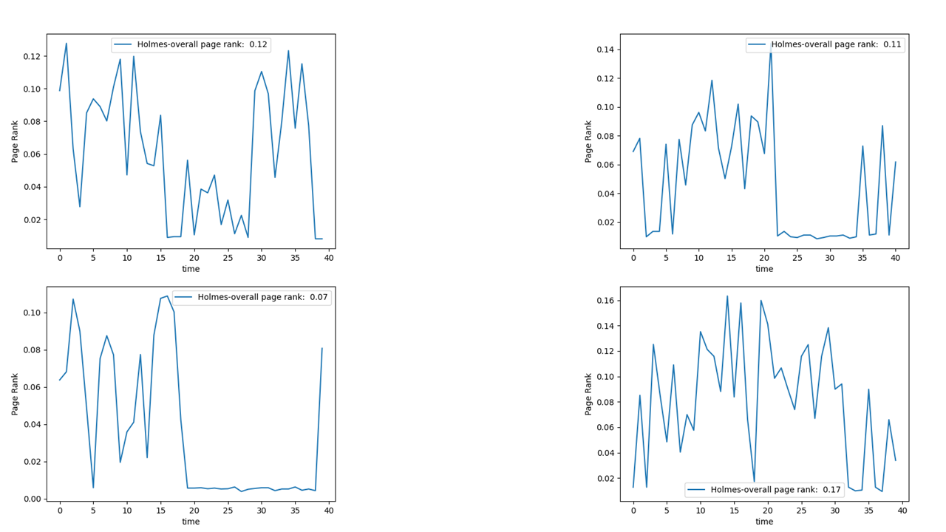
Results: Main Character Pattern
The Hound of the Baskervilles
A Study in Scarlet
Absence of Sherlock Holmes
The Sign of the Four
The Valley of Fear
Notes:
Importance (Page-Rank) through the time is plotted for the main character of four books of Sherlock Holmes series by Arthur Conan Doyle.
Each book is divided to 40 sections. As they are shown in here There is a pattern for the presence of the main character in 3 of them. (up left - up right - down left)
But in the “The Sign of the Four” novel, there is a different narration pattern for the main character.

Slide 16
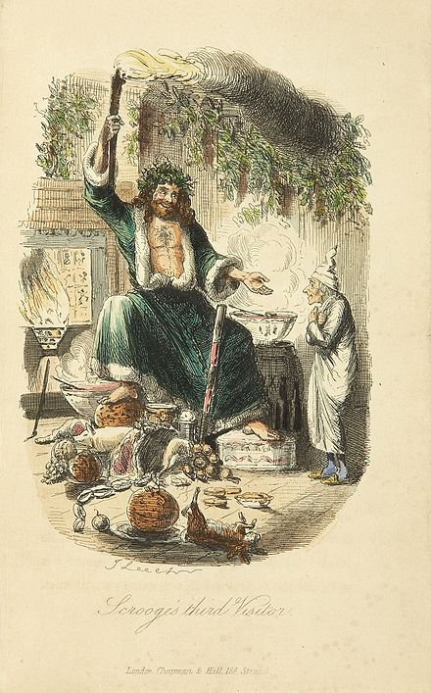
Limitations and Future Work
Character Names
Pronouns are ignored ( I -> first person narrator).
NER tagger does not know strange names.
Similar characters: When the characters’ name changes (Tom Riddle is Voldemort)
Numerical measures for comparing the books
Future Work:
Improving accuracy of the graph
Analysing single books
Comparing books
Scrooge encounters the Ghost of Christmas Present - illustration by John Leech (1843) Wikipedia
Notes:
About limitations, The most important limitation is the NER tagger doesn’t know strange names. For example this character’s name is the ghost of Christmas present, in A christmas carol, and our method totally ignores him and his fellow spirits. Another thing is that we ignore pronouns. This might not be a big problem, but in first person narrator books ignoring I might cause problems. Similarity checking impossible cases.

Slide 17
Concluding Remarks
Character Interaction Network
Patterns in story development
Structure of the writing
Literary Analysis
For analysing books the interaction network is extracted manually.
Finding repeated patterns between books
Summarising
Notes:
What we’re planning to do in the remaining weeks is to first improve the character network by reading paragraph by paragraph. Then we will create the graph for more books and see if we can find any interesting patterns in single books. Or any repeated pattern in groups of books. NOTE: can merge 4 and 5; and 9 and 10. Can remove 11 (has nothing very interesting)

